Slide 1
Log File Analysis Executive Summary
Jerson Vargas

Slide 2
Glossary
Log File- Software- generated files containing information about the operations activities, and usage patterns of an application,server, or IT system.
Python- A high-level, general-purpose programming language.
Parse- Analyze into logical syntactic components, typically in order to test conformability to a logical grammar.
Security Audit - A systematic evaluation of a companies information systems, networks, and physical infrastructure.

Slide 3
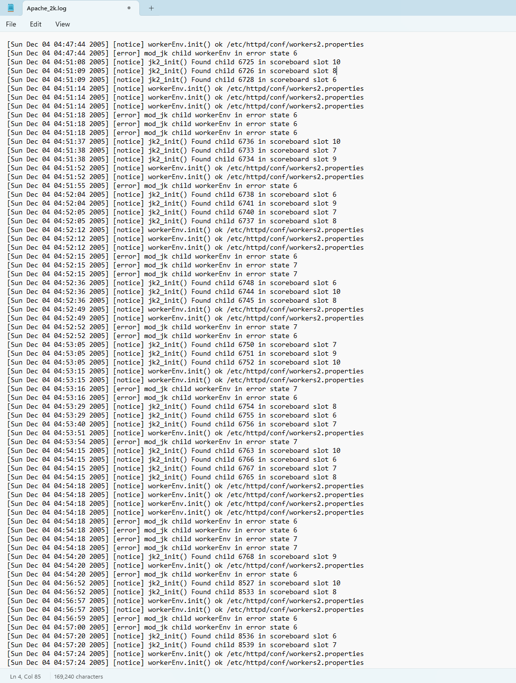
Overview
We will be using an Apache error log file found online that contains various types of server-side issues. The analysis will focus on extracting timestamps, error levels and messages from each log entry to gain insight into the server operational status.
Log File:

Slide 4


Key Findings

Slide 5
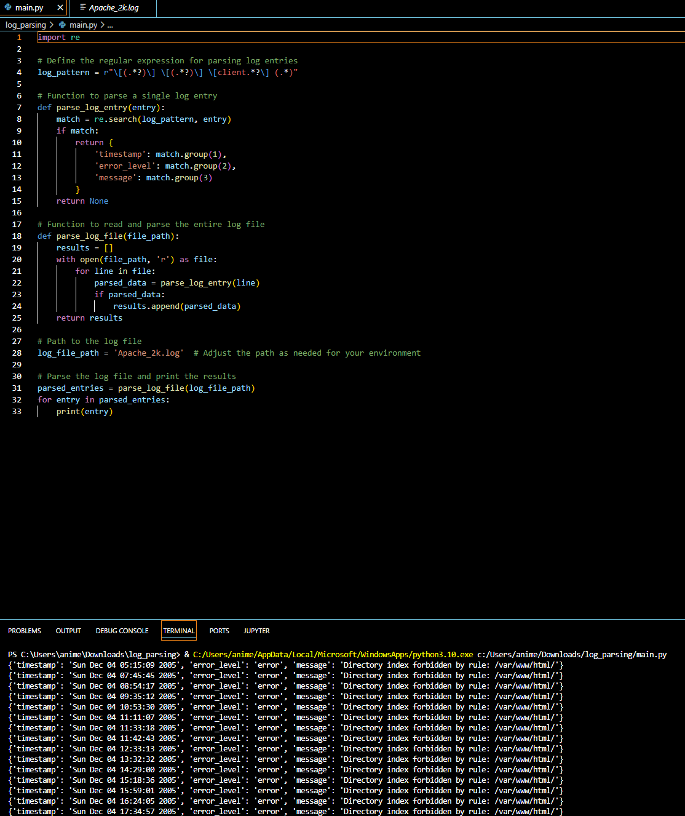
Total Entries Analyzed
The file contained 32 error entries, Indicating incidents where the server encountered issues significant enough to log an error. Below is a script in Python parsing the error messages out of the Apache log file.

Slide 6

Types of Errors
Error - Level was commonly seen in entries related to resource access issues, such as missing files.
Warning- Security-Related warnings, such as access denials, were noted, which may suggest potential unauthorized access attempts or misconfigurations.
Notice- Contained operational information that is not indicative of errors but provides insights to the servers status.

Slide 7
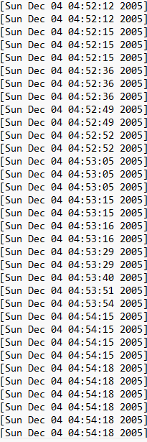

Error Distribution Over Time
Item 1
Item 2
The entries span various timestamps, providing a timeline of when issues occurred. This can help in understanding peak times of issues or identifying patterns related to server behavior under different loads or attack vectors.
35
25
22
15

Slide 8
Recommendations
Resource Validation
Investigate and rectify the recurring resource not found by errors by ensuring all referenced files are correctly placed.
Update links to avoid server strain from handling these errors.
Security Audits
Conduct regular security audits to identify and mitigate configuration abilities, as suggested by the presence of access denials which could indicate potential security risks.
Performance Monitoring
Implement comprehensive monitoring and logging strategies to track server performance and error rates over time.
Aids in proactive management and quick resolution of issues before they affect user experience.

Slide 9

Conclusion
The parsed log file reveals a series of errors that, while not critical, indicate areas for potential improvement in server management and security posture.
Addressing these findings will help improve server reliability and security, ensuring better service continuity and user satisfaction.

Slide 10

Source
Jieming Zhu, Shilin He, Pinjia He, Jinyang Liu, Michael R. Lyu. Loghub: A Large Collection of System Log Datasets for AI-driven Log Analytics. IEEE International Symposium on Software Reliability Engineering (ISSRE), 2023.

